Slide 1
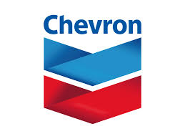
CHEVRON
By: Joshua Okonofua, Rayshon Lawrence, Ansumana Badjie, Kamryn Smith

Slide 2
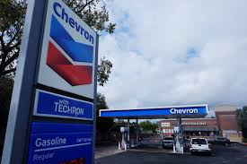
Company Background Information
Industry: Oil & Gas
Founded: 1879
HQ: San Ramon, California
Operates In: 22 U.S. states
Also Operates Nationwide
Main Country Outside U.S.: Nigeria
Known For:
Chevron & Texaco gas
Oil drilling & refining
Natural gas & clean energy

Slide 3

Chevron Network Defense Strategy
Layered Security: Firewalls, antivirus, and monitoring to block threats at every level. (Stops hackers from getting in multiple ways)
Oil System Protection: Critical machines are on their own secure network. (Keeps drilling and pipeline systems safe)
Zero Trust: Only the right people get access with strong logins. (Prevents hackers from moving around)
24/7 Monitoring: Security teams watch for attacks all day. (Attacks can happen anytime)
Backup Plan: Fast response if something goes wrong. (Keeps the company running)
Employee Training: Workers learn to avoid:
Phishing (fake emails)
Vishing (fake calls)
Smishing (fake texts)
Malware links (bad websites) (Employees are often the first target)

Slide 4
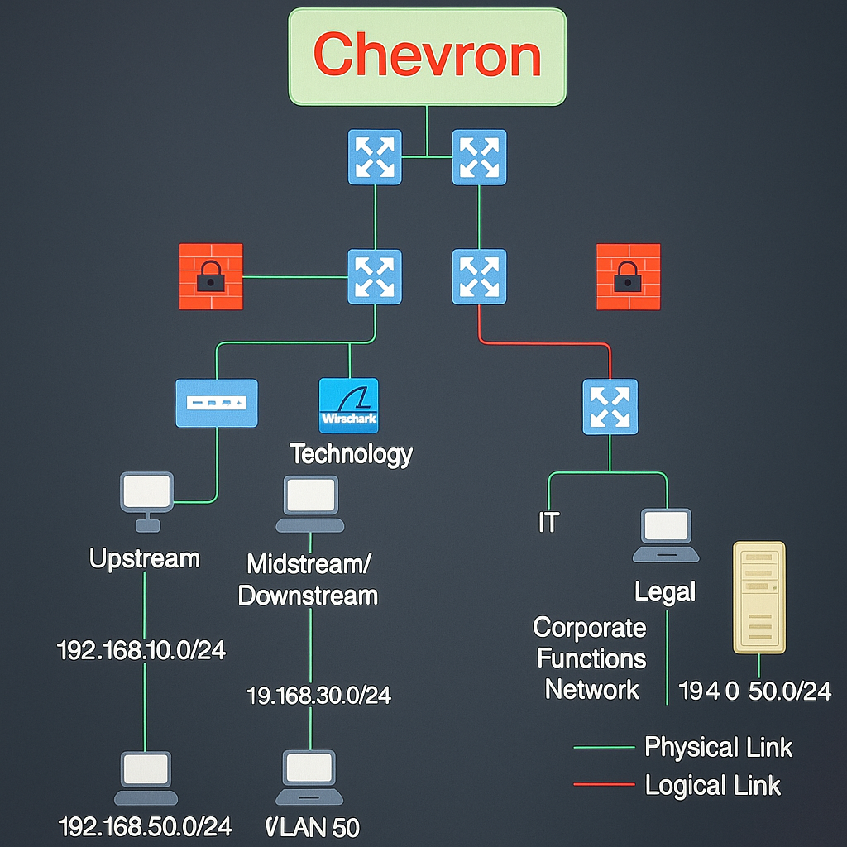
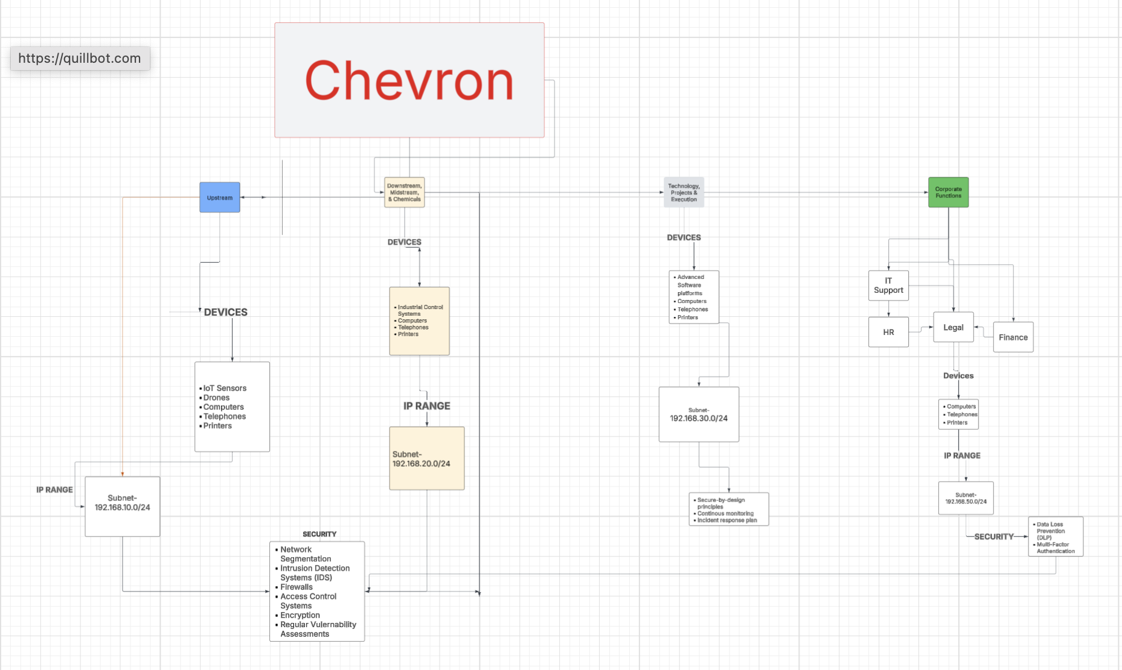
Logical And Physical Topology
These are Chevron’s physical and logical network topology, integrating Wireshark for monitoring and applying NIST controls
Chevron Core Network (Top Center):
The Chevron logo sits at the top, connected to core switches.
These switches represent the core layer, which connects all business units and routes internal and external traffic.
Logical and Physical Links:
Green lines = Physical connections (actual cables or network infrastructure).
Red lines = Logical connections (how data moves between systems, like VLANs or secure tunnels).
Firewalls (Red Icons with Lock):
These separate internal departments for security segmentation.
Used to enforce policies between zones (e.g., Upstream and Corporate should not talk freely).
Placed in the Technology segment, Wireshark monitors cross-departmental traffic.
This allows detection of threats like:
Unauthorized pings
Misconfigured firewall traffic
Data leaks across VLANs
This placement supports the Detect and Respond functions in the NIST Cybersecurity Framework.

Slide 5
NIST Control Families: Josh & Rayshon
Awareness and training ®
At Chevron, security is everyone’s responsibility. The Awareness and Training control family ensures that all employees, including field engineers and office staff, are regularly trained on cybersecurity risks, phishing, and the safe use of digital systems. It reduces human error, which is the leading cause of breaches, and promotes a strong security culture across departments.
Media protection ®
Chevron also handles drilling data, financial data, and control system logs. Media protection ensures that the data, both physical and digital, is stored and transferred securely. It’s important for preventing data leakage during transfers. And ensuring the confidentiality of sensitive operational and legal information.
Physical and Environmental Protection ® Includes the biometric access to server rooms, surveillance cameras, and environmental controls in data centers. This ensures the system remains operational in emergencies and prevents physical tampering or unauthorized access via keycard and fingerprint access to server rooms.
Personnel Security ®
Is crucial in a company like Chevron, where insider threats and unauthorized data access must be mitigated through personnel policies. This is ensured by background checks and deprovisioning when employees leave. It ensures that only trusted personnel handle sensitive data.
Program Management ®
Ensures Chevron has a centralized governance model for cybersecurity. It aligns cybersecurity with business goals. Practices such as regular audits and risks assessments ensure consistent security policy enforcement across global operations. Also, ensure compliance with industry and federal regulations.
System and Services Acquisition (J) Purpose: Ensures secure and functional systems from the start. Controls: - System acquisition planning – Supply chain Protection and security requirements.
Chevron ensures new systems work well and are resilient to failures
Security Planning (J) Purpose: Establishing a security framework before deployment Controls: - Risk Identification – Prioritization of risks – Backup planning –Vulnerability planning
Chevron asses their network for any potential issues or vulnerabilities.
Privacy Controls (J) Purpose: Protects personal information through data and access controls. Controls: -Identity and access management –Data encryption – Role based access – Device Security
Chevron restricts and safeguards sensitive information.
Security Assessment and Authorization (J) Purpose: Evaluates and monitors systems to meet security standards. Controls: - Security testing – System monitoring – Audit requirements – Incident Alerting
Chevron monitors and reviews systems to ensure ongoing security.
Risk Assessment (J) Purpose: Identifies and prioritizes risks to reduce potential threats. Controls: - Risk identification – Prioritization of risks – Backup planning
Chevron assesses their network for any potential issues or breach points.

Slide 6
NIST Control Families: Kamryn & Ansumana
Access control (K): Access control is the process of limiting access to resources, data, and systems to just approved users. Access control allows Chevron to guarantee that only authorised staff members or contractors may access important systems including financial records, oil rig control systems, or private R&D material. This lessens both internal and external risks.
Identification and Authentication (K): Identification is claiming an identity of a username, and authentication is verifying that identity of a password, badge, or biometric. Chevron employees log into systems using credentials or smart badges. In sensitive places like control rooms or cybersecurity systems, multifactor authentication (MFA) may find application.
Configuration Management (K): Through consistent settings and modification restrictions, configuration management that is, preserving the security and operation of IT systems allows Whether in headquarters, refineries, or offshore platforms, Chevron makes sure all of its systems including security-oriented configurations are set according to standards; all changes are recorded and examined to prevent creating vulnerabilities.
Audit and Accountability (K): Refers to monitoring system activity and, via logs and audits, making users answerable for their activities. Whether in headquarters, refineries, or offshore platforms. Chevron makes sure all of its systems, including those related to security are set up in line with guidelines; any modifications are recorded and examined to prevent creating weaknesses.
Contigency Planning (K): Developing strategies to keep or restore operations under unanticipated circumstances include system faults, cyberattacks, or natural disasters. To guarantee business continuity and safety even in crisis, Chevron has contingency measures in place for significant events including refinery outages or cyberattacks on pipeline control systems.
Incident Response (A): A systematic approach for mitigating and controlling the fallout after a cybersecurity attack or breach. If Chevron finds malware or illegal access on a system, their cybersecurity team has an incident response strategy to limit, probe, and restore from the danger, so minimizing corporate impact.
System and Communications Protection (A): Protecting data integrity as it moves between systems and networks. To guard private data and guarantee safe communication. Chevron encrypts data transferred between corporate offices, drilling platforms, and data centers.
System and Information Integrity (A): Information systems and the data they handle should be accurate, dependable, and guarded from illegal modifications. To guarantee operational integrity. Chevron routinely fixes systems and employs antivirus and monitoring tools to find and correct data corruption or vulnerabilities.
Supply Chain Risk Management (A): Controlling hazards related to outside vendors, suppliers, and partners who might compromise the operations or security of a company To guard private data and guarantee safe communication. To make sure its contractors, software providers, and equipment suppliers don't bring vulnerabilities into Chevron's system, the company evaluates their cybersecurity policies.
Maintenance (A): Frequent system and equipment upgrades and repairs help to guarantee dependable and safe operations. To avoid failures and patch security problems, Chevron plans maintenance for both IT and operational technology (OT) systems including refinery automation systems or drilling control software.

Slide 7
Business Continuity Plan – Kam
Chevron's Business Continuity Plan (BCP) ensures that essential operations, such as oil production, pipeline management, and financial systems, remain functional during disruptions like natural disasters, cyberattacks, or power outages. The BCP aims to minimize downtime, safeguard personnel, and facilitate rapid recovery.
The Contingency Plan involves establishing alternative suppliers, enabling remote work setups, and relocating operations to unaffected sites when necessary.
The Incident Response Plan focuses on the swift detection and containment of cyber threats or system failures. It outlines clear communication protocols and immediate recovery procedures to mitigate damage.
The Emergency Response Plan prioritizes safety through well-defined evacuation procedures, regular drills, and coordination with local emergency services to address incidents like fires or chemical spills.
For Backup & Recovery, Chevron conducts daily data backups to secure offsite locations, employs failover systems for critical operations, and regularly tests recovery processes to ensure quick restoration with minimal data loss.
Collectively, these strategies enable Chevron to maintain operational resilience, protect its workforce, and swiftly recover from unforeseen events.

Slide 8
Business con Disaster Recovery Plan- Ansumana
1. Risk Assessment: Chevron must identify threats like natural disasters, cyberattacks, and equipment failure at each facility. They need regular risk reviews to prepare ahead of time.
2. Data Backup & Redundancy: They must back up data daily and weekly, store it in multiple secure locations (cloud + physical), and test backups often to ensure quick recovery.
3. Failover Systems: Chevron must set up backup systems (like SCADA and ERP) that can take over instantly if the main ones fail, using global data centers.
4. Incident Communication: They must have an emergency contact plan, alert tools (texts, secure apps), and clear steps for who talks to staff, media, and regulators.
5. Testing & Validation: Chevron needs to run regular disaster recovery tests—like drills, system failovers, and cyberattack simulations—to stay ready and improve plans.
6. Resource Allocation: They must assign trained teams in each region, fund disaster recovery every year, and have deals with vendors for backup equipment and help.
7. RTO & RPO Targets: Chevron must recover critical systems (trading, control) in under 1 hour and not lose more than 15 minutes of data. Less critical systems get more time.
8. Business Priorities: They must restore most important functions first:
Oil trading & control systems
Financial systems & communication tools
HR and internal websites

Slide 9
References
Security Scientist. (n.d.). NIST SP 800-53 control families explained. SecurityScientist.net. https://www.securityscientist.net/blog/nist-sp-800-53-control-families/
Chevron. (n.d.-a). Technology and innovation. https://www.chevron.com/what-we-do/technology-and-innovation
Chevron. (n.d.-b). History. https://www.chevron.com/who-we-are/history
Chevron. (n.d.-c). Cybersecurity and operational excellence. https://www.chevron.com/who-we-are/culture/operational-excellence/cybersecurity

